Slide 1
Prposals for Soft Matter Physics Laboratory Coursework
Moein Derakhshan
Farane Khodadi

Slide 2
Selected experiments
3
4
7
8
1
2
Hysteresis
Dewetting
Marangoni
patterns
Hydraulic jump
5
6
Bubbles
Soap film
Hele-shaw
Camphor boats

Slide 3
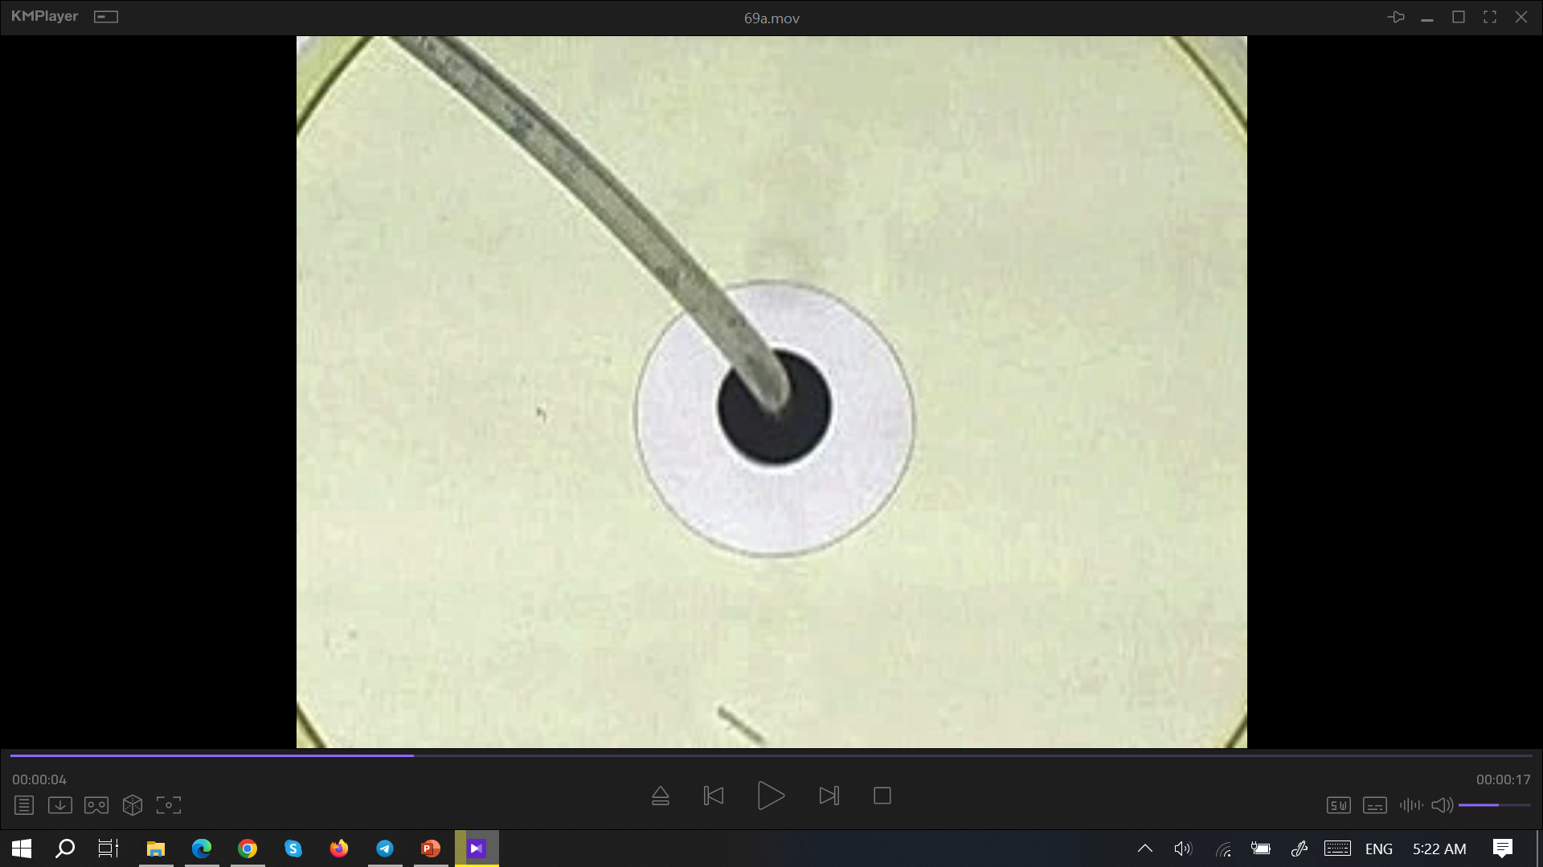
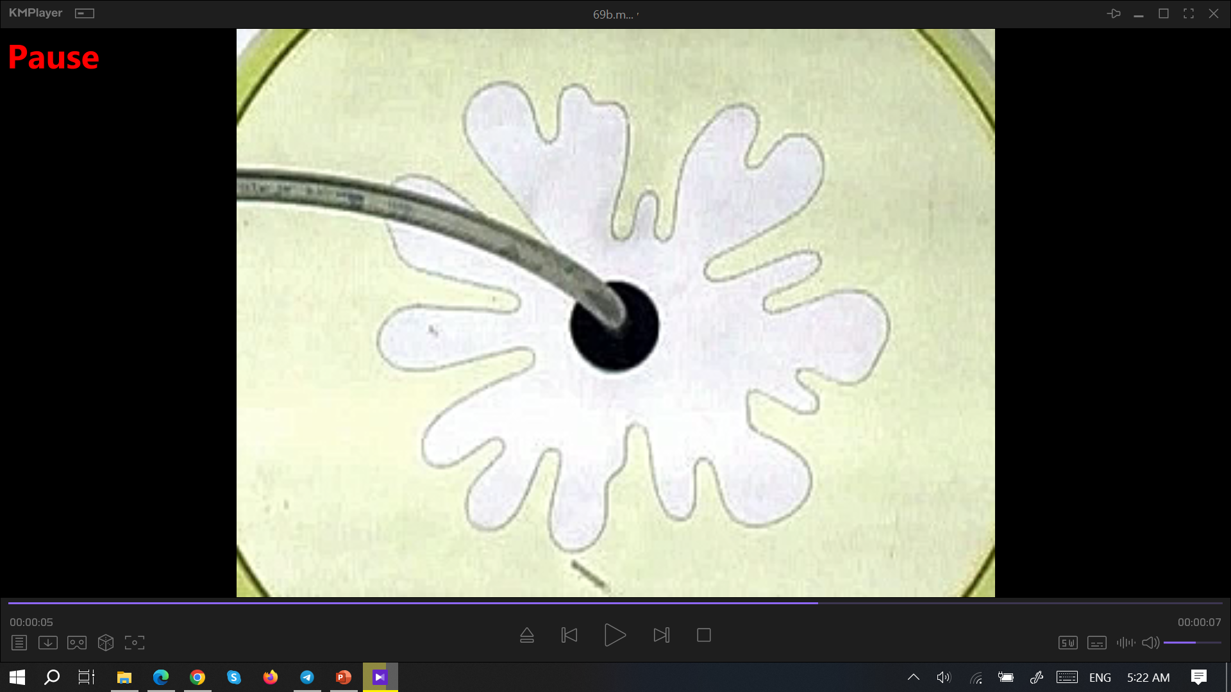
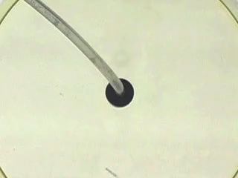
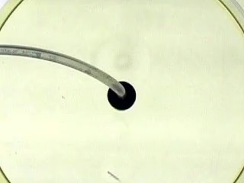
Hele – Shaw cell experiment
This experiment showcases the pattern formed by the flow of a viscous fluid into a more viscous fluid, highlighting the role of propagation speed within a Hele-Shaw cell.

Slide 4
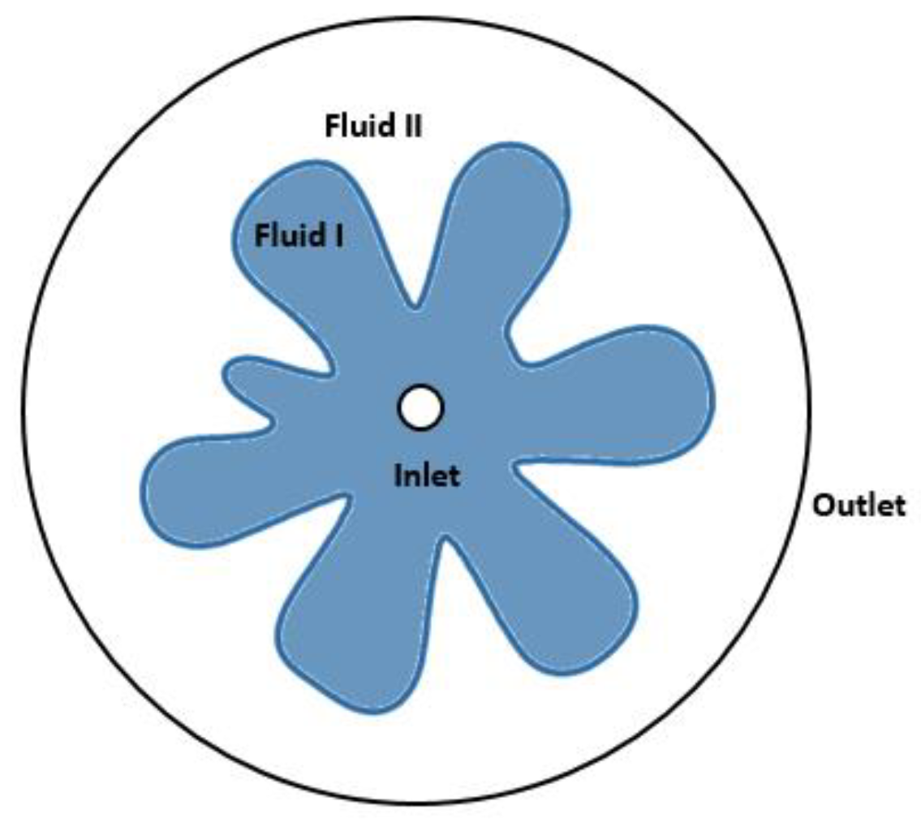
The penetration of a fluid into a Hele – Shaw cell containing a more viscous liquid
A Hele – Shaw cell consists of two sheets of glass placed a millimeter distance from each other. This cell is filled with the more viscous fluid. When the fluid is driven forwards by the pressure of the less viscous fluid, the interface between them is liable to be unstable based on the injection speed. at low injection speed, fluid I regularly pushes the fluid II; At higher speeds, the interface is unstable and is structured into petals or fingers. This is called the Saffman-Taylor instability.

Slide 5
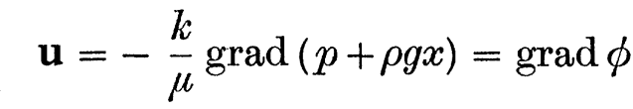
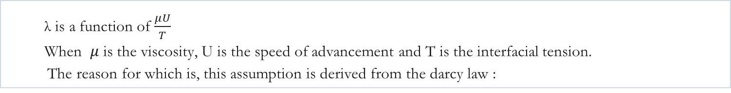
To examine these patterns, we will model a wave function to represent each finger as a peak. By determining the wavelength, we can predict the expected number of fingers in the pattern.
Flow is possible in which equally spaced fingers advance steadily. The focal point of this experiment is the lambda value, which is described as :
The ratio λ=(width of fingers)/(spacing of fingers)
λ is a function of $\frac{μU}{T}$
When $μ$ is the viscosity, U is the speed of advancement and T is the interfacial tension.
The reason for which is, this assumption is derived from the darcy law :

Slide 6
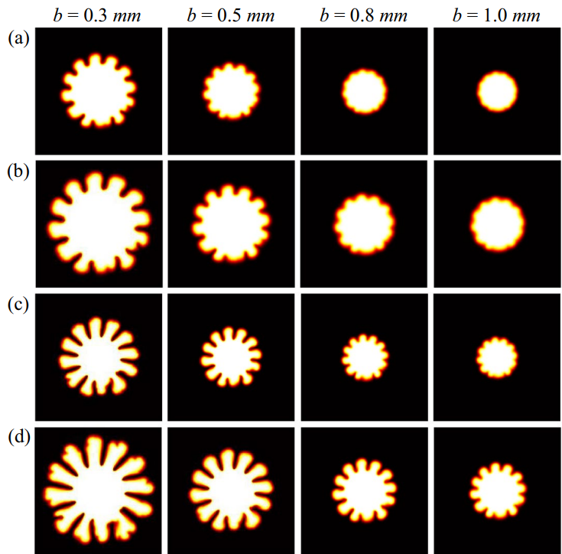
Hence, the primary fluid characteristics impacting the pattern formation are the fluid velocity, the type of fluid being utilized, and the gap distance between the cell plates.
a and c : U = 5 mm/s
b and d : U = 10 mm/s

Slide 7
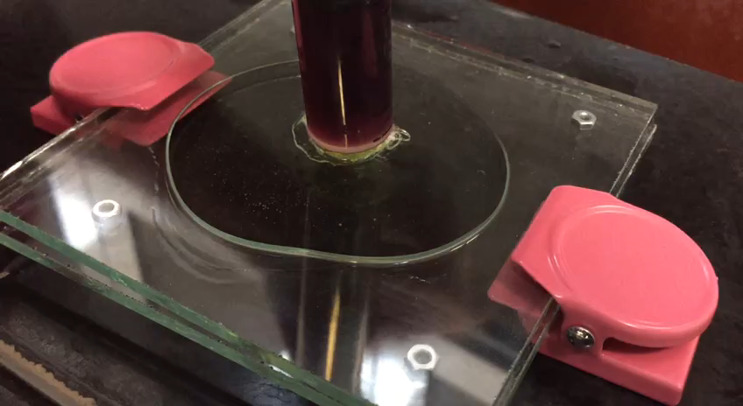

Slide 8

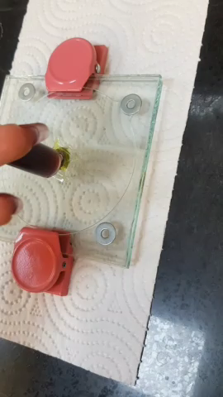

Slide 9
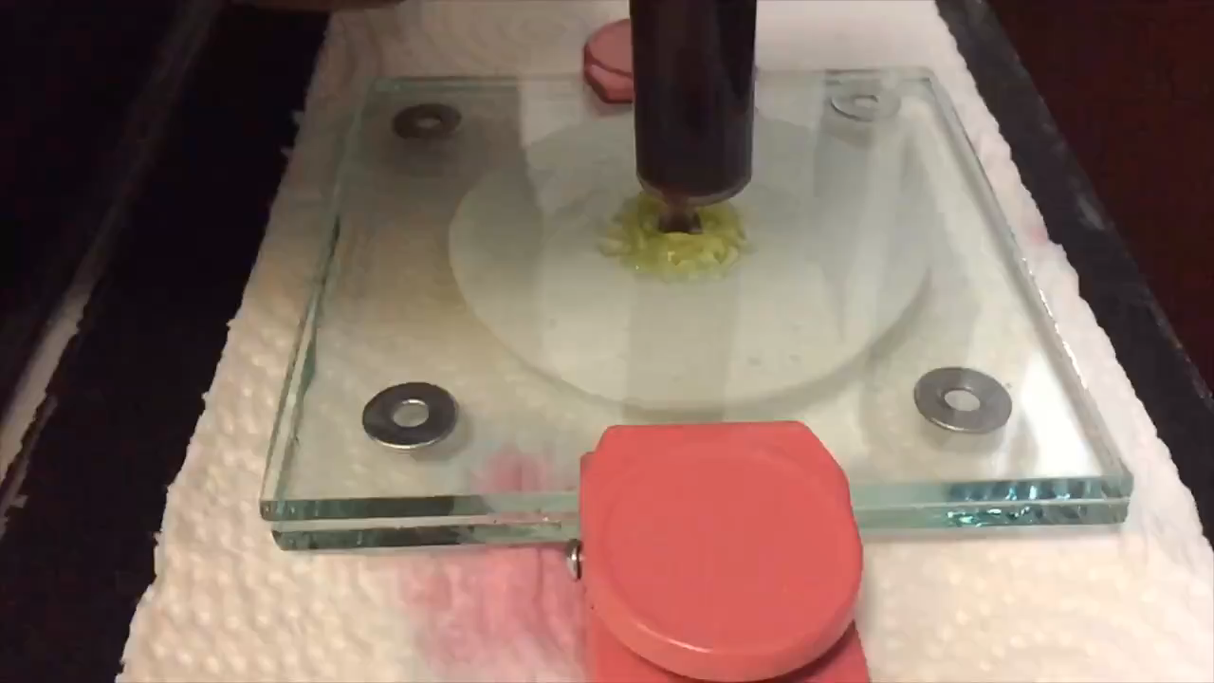
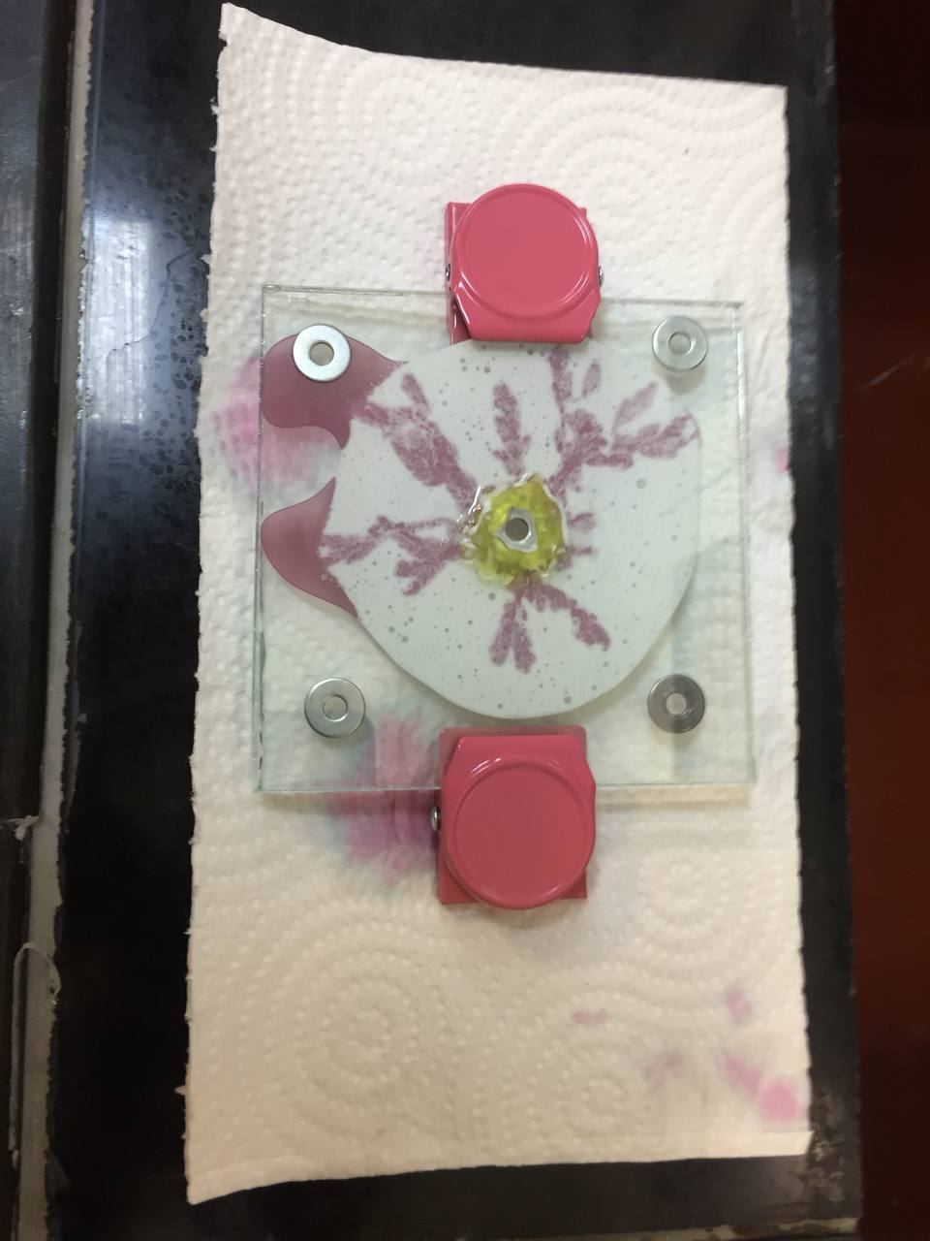

Slide 10
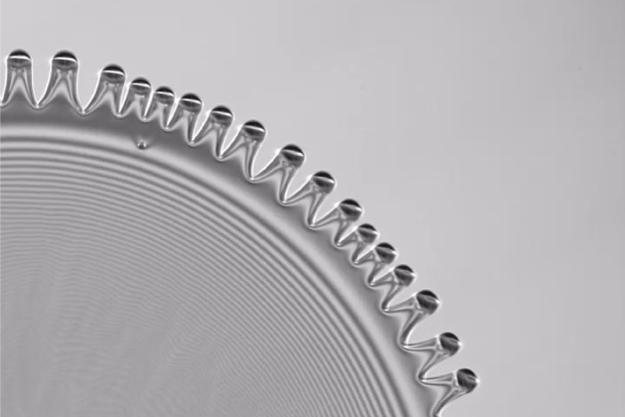
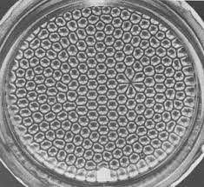
1
Marangoni effect
mass transfer along an interface between two phases due to a gradient of the surface tension.
Caused by concentration gradient or by a temperature gradient.
forming fingers or drops (i.e. Tears of wine).
behavior of convection cells (Benard cells).

Slide 11
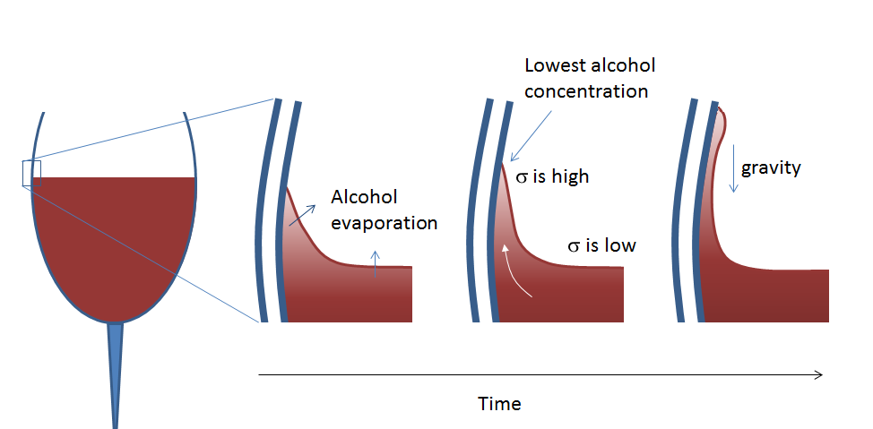

Slide 12
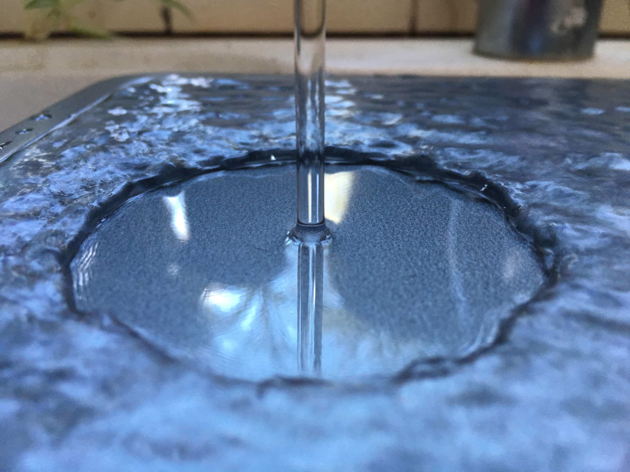
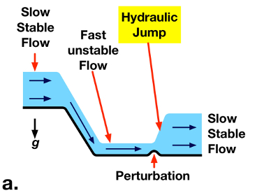
2
Hydraulic jump
liquid at high velocity discharges into a zone of lower velocity, a rather abrupt rise occurs in the liquid surface.
dependent upon the initial fluid speed
critical speed

Slide 13
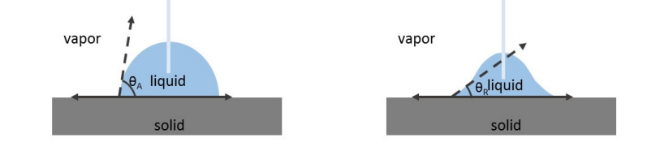
3
Contact angle hysteresis
The droplet at equilibrium state will form a unique contact angle in the vicinity of the triple phase contact line. The contact angle can be linked to the force balance among the solid-liquid-gas three interfacial tensions.

Slide 14
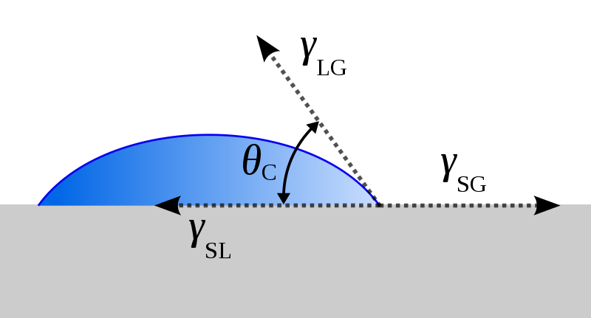
From the perspective of thermodynamics, the hysteresis is because of the existence of different energy metastable states caused by energy barrier on real solid surfaces. In the macroscopic concept, this phenomenon is closely related to the pinning force at the triple-phase contact line, affected by the surface roughness, liquid penetration, surface deformation and so on. Also, the long-range interactions between molecules, such as van der Waals force, play a non-negligible role in contact angle hysteresis at nanoscale.

Slide 15
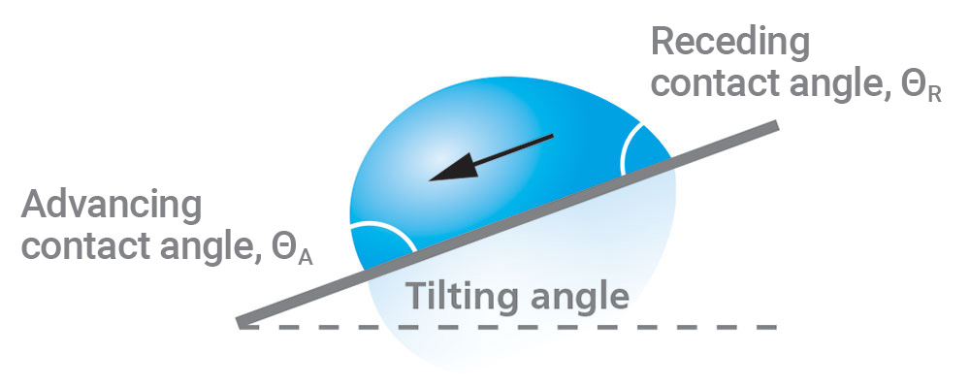
When the support is slightly tilted, an asymmetry appears between the front and back of the drop, which has the effect of generating a force opposing the weight. When we tilt the support too much, we go outside the range allowed for these angles, and the drop begins to move. The inclination at the drop depends on the volume of the drop; but droplets that are too small will remain stuck whatever the inclination.

Slide 16
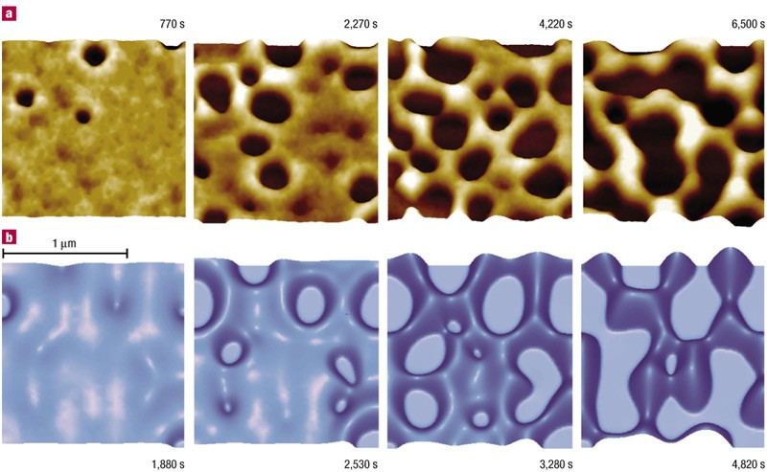
4
Dewetting
The Hele-Shaw analogy is a demonstration of the two- dimensional steady-potential flow of an incompressible fluid around an obstacle.

Slide 17
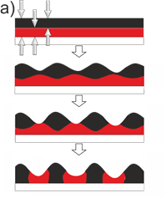
Dewetting is the retraction of a fluid from a surface it was forced to cover. The wettability of a surface by a liquid is to a large extent characterized by the interfacial tensions and is reflected by the contact angle. However, it is difficult to investigate kinetic effects. In this context, thin polymer films provide convenient systems due to their high viscosity (enabling time resolved measurements) and their non-volatility (assuring mass conservation). Dewetting allows to link molecular and interfacial properties with macroscopically observable parameters like dewetting velocity and shape of the rim.

Slide 18
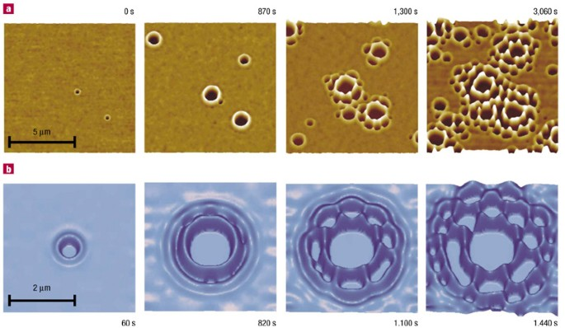
The displacement of a contact line reflects kinetic effects at a polymer-polymer interface. Due to the balance of (capillary) driving forces and energy dissipation at the interface as a consequence of intrinsic properties controlled by molecular interactions, a dewetting film is at all stages self-adjusting to any variations of experimental conditions. The main driving force for dewetting is due to an imbalance between the three interfacial tensions of the liquid air, liquid-substrate, and substrate-air interfaces which meet at the three-phase contact line. This capillary force is related to the difference between the dynamic (during dewetting) and the equilibrium contact angle.

Slide 19

5
Motion of bubbles
The bubbles remain spherical and rise up rectilinearly when their diameters are small enough. Otherwise, the bubbles begin to deform to ellipsoidal, oblate ellipsoidal, or cap shape, with surface wobbling strongly, and proceed in a zigzagging, helical, nearly zigzagging or helical motion.

Slide 20
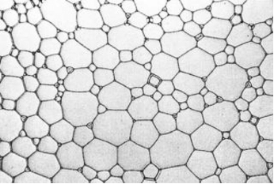
6
Soap bubbles
Two dimensional foams; Crushed between two plates of glass, it becomes two dimensional and easily observable.
Exploring motion of a Bubble in this area.
Transforming onto one dimension: when the distance between soapy lamellae becomes of the order of the width of the channel

Slide 21
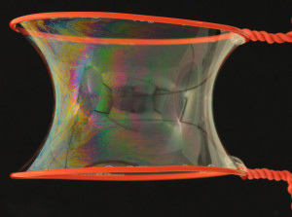
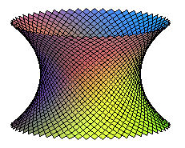
Pinching of a catenoid
Because of surface tension, soap ﬁlms seek the shape that minimizes their surface energy, and thus their surface area.
Variation of diameter and the soap concentration
Changing the ring into different shapes.

Slide 22
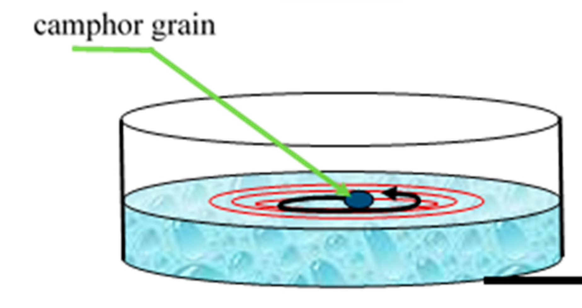
8
Comphor boats
Camphor attached to a boat allows it to propel itself. Camphor is a volatile solid soluble in water which lowers the surface tension of the latter, so that the boat is pulled by the difference in the tensions of pure water and camphor water.

Slide 23
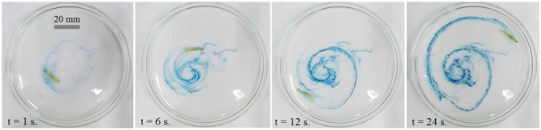
Single boat
This behavior was caused by the relationship between surface tension and camphor concentration on the surface of water. For low camphor concentrations, boats may experience a stronger driving force by traveling close behind other boats. An order parameter can be defined to quantify the clustering behavior and applied it to the results of numerical simulations to examine the dependence on system parameters.

Slide 24
Multiple boats
Various kinds of of synchronization, phase-locking and phase-oscillatory modes, could be produced by changing the temperature, the radius of the circular cell, and the mass of each boat The boats display either roughly homogeneous, constant velocity flow or congested flow depending on the number of boats in the system. With a larger number of boats and is characterized by periodic acceleration and deceleration.

Slide 25
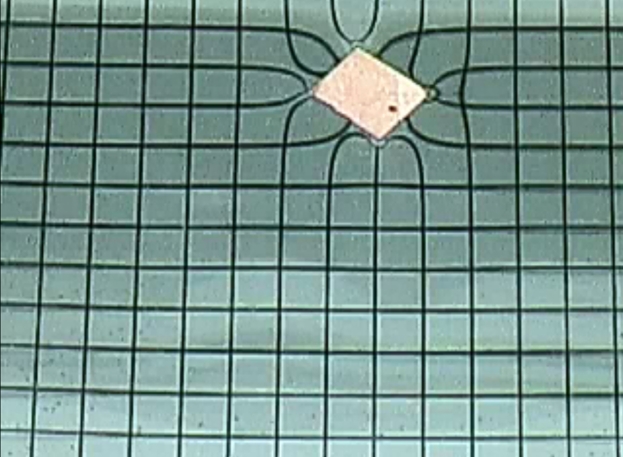
9
Capillary attraction
The meniscus forms an angle θ, the contact angle, with the inner wall of a capillary tube with circular cross section. The contact angle is determined by the ability of the liquid to wet the inner surface of the tube.

Slide 26
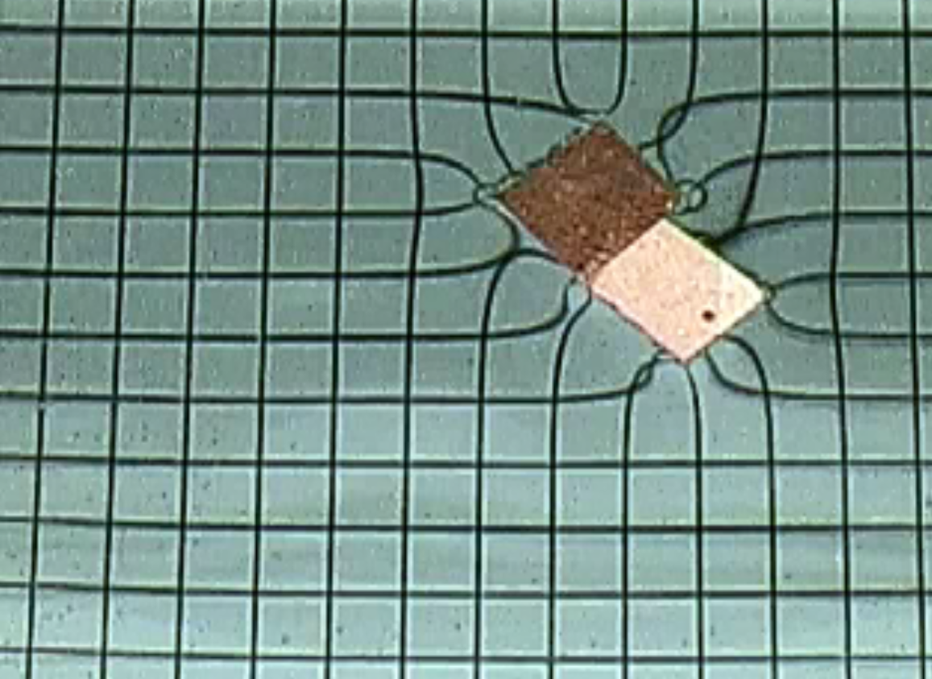
The existence of a curved meniscus is a consequence of the universal condition that the chemical potential µ of the liquid must be the same everywhere in the system at physicochemical equilibrium. As a result of gravity, the potential energy increases with the height in the liquid column, which per se increases the chemical potential. It is the increase in chemical potential in the liquid column owing to the gravitational field that causes the meniscus to curve to maintain physicochemical equilibrium.

Slide 27
Free energy is gained when the liquid wets the wall, which is counterbalanced by the work needed to lift the liquid column in the gravitational field. Since, for an incompressible liquid, this is a process occurring at constant volume, the equilibrium condition is that the Helmholtz free energy A is at minimum. Increasing the column height at constant temperature from h to h + dh without changing the shape of the meniscus causes a change in the Helmholtz free energy of the system. Therefor, when 2 walls are close enough, they stick together in order to lower their free energy.

